Slide 1
Lecture 5
The X-Ray Diffraction Experiment
The 3d Structure of Myoglobin – what should we notice?
What are the “construction rules” for proteins?
Lecture 5 Learning Outcomes:
What is light?
What was “the phase problem”?
What are the six categories of non-covalent interactions? Why do we care?

Slide 2


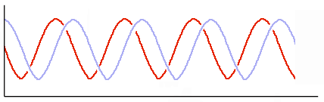
The x-ray diffraction experiment
X-ray waves diffracted by protein crystal
Scattered in all directions by every atom!



As used to study protein crystals: “Protein crystallography”
X-ray beam

Cornell has a great x-ray source: CHESS Cornell High Energy Synchrotron Source

=

=
Protein crystal
A precise arrangement of atoms

Charge-Coupled Device, digital imaging

Measure diffracted x-ray waves showing up on CCD camera as dark spots:
Direction
Intensity
X-ray wavelength
Phase
Detector, e.g. CCD camera
j
The x-rays are scattered by the atoms in the protein crystal. These 4 wave properties
Oh no!
k
l
Only the spot intensity is detected: Lose all phase info!
m
contain all info needed to solve 3D arrangement of those atoms!
Light = photons
Took 30 years to solve "phase problem"
Currently, limiting factor for solving protein 3D by x-ray is good crystals
X-ray beam (high energy light!) = oscillating electromagnetic wave with particle and wave behavior
Notes:
The x-ray diffraction experiment involves directing a beam of very high energy LIGHT into a protein crystal and recording the pattern of scattered light using a detector. A protein crystal is a regularly spaced 3d array of uniformly aligned protein molecules; there is an identical set of atoms that are repeated throughout the crystal. Crystals can form from a high concentration of highly pure protein in aqueous solution is combined with agents that can favor crystallization such as salts or propylene glycol. So, a protein crystal still has a LOT of water that is within it, and water molecules interact with the protein! So the water molecules are often detected along with the protein.
But what exactly is light, and why does an X-ray beam hitting a crystal make a scattering pattern?
Light is composed of photons. Photons are packets of pure energy; they have no mass and they have a specific amount of energy that determines their wavelength, or equivalently, their frequency (recall that wavelength and frequency are inversely proportional, short wavelength is high frequency and high energy!). Light (equivalently, a photon) is an oscillating electromagnetic WAVE. As a wave it has direction, intensity, wavelength, and phase as shown. These 4 wave properties contain all of the information needed to solve the 3D arrangement of atoms in the crystal!
Light (each photon in a light beam) has BOTH particle and wave behavior. It acts like a particle when it scatters off an object (such as atoms in the protein crystal!) and it acts like a wave when it undergoes INTERFERENCE. When two waves have different phases, they undergo constructive and destructive interference (as shown in the double-slit experiment of Thomas Young).
When x-rays are scattered by the ELECTRONS of the atoms in the protein crystal, the scattered rays go in all directions. Because these rays travel slightly different distances, depending on the 3D arrangement of the molecules and atoms in the crystal, the rays that hit the detector show a pattern of “spots” (high intensity) due to this interference. Every atom in the crystal contributes to the intensity of every spot! So, the 3D arrangement of the atoms in the protein determines the variation of spot intensities across the scattering pattern! The spot intensities are recorded by the detector (in general this is a Charge-Coupled Device (CCD) detector that is used in digital imaging). NOTE: most protein crystallography experiments are done at 77 K (cryogenic temperatures!) to reduce the damage that results from the very high energy light scattering from the protein (“radiation damage”)? The cold temperatures also help to reduce motions of the protein and the waters interacting with it!
BUT, in order to interpret the scattering pattern to determine the 3D arrangement of atoms that gave rise to this pattern, we NEED BOTH the INTENSITIES and the PHASES of the scattered rays that gave rise to the measured spots. And OH NO! Only the intensities are detected. We lose all of the phase information. However, by developing clever “tricks”, namely by changing (perturbing) the scattering pattern a little bit, the phases can be solved. After many years of hard work by people such as Dorothy Crowfoot Hodgkin, the phase problem was solved!
The main hurdle now is whether or not a given protein can be coaxed into a highly ordered array, or into a “good crystal”!
Cornell has a great x-ray source that is used for X-ray crystallography!

Slide 3
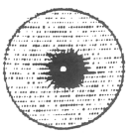
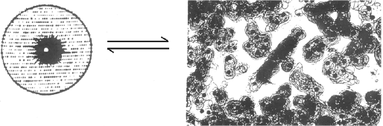
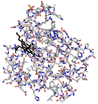
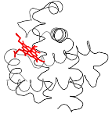
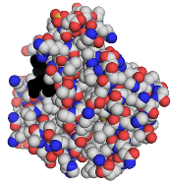
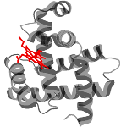
F helix
Fourier transform spot data into e⁻ density of Mb atoms
Proximal His
Distal His
Heme
x-ray diffraction from crystal of Mb
E helix
Sticks
Ribbon
Many different ways to show protein structure
Spheres
Cartoon
Notes:
An example of part of the Mb crystal x-ray diffraction pattern is given at the left top of this slide (p. 50 in the LG).
The actual amount of “spot data” needed is greater than the ~600 spots shown at the top left of p. 50; about 10,000 spots were needed to find the structure of Mb, a part of which is represented as the "electron density map" in the upper right on p. 50.
1. In the center of that picture, on a diagonal, is the heme group.
2. The surrounding (black) protein electron density consists of different AA parts of Mb, parts that will become familiar to you soon, but not quite yet.
3. Close to either flat side of the heme is a His, each His sidechain extending from a helix.
Refer to the middle/bottom of p. 50:
The upper left picture shows what PyMol terms a "sticks" model. This representation is useful when you can zoom in, since each atom of each AA, as well as the heme, is clearly shown.
Proceeding clockwise, next see the Mb "ribbon", which shows the path of the main chain. This means simply that no AA side chains are shown.
Next the "cartoon" representation (PyMol terminology) clearly reveals the predominance of alpha-helices, of which there are eight, labeled as helices A-H.
The last picture is "spheres", the space-filling model of Mb. The slightly darker part on the left is the heme group. This is a "true" representation of Mb, but it does not show the underlying patterns of the structure.

Slide 4
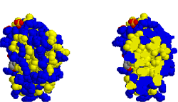
X-ray diffraction results for Mb
2. Compact 45 x 35 x 25 Angstrom
3. α-helix
4. Heme in a crevice
5. Nonpolar interior
6. Mb surface
7. AA side chains where O₂ binds
8. One His near O₂ binding site
Note: H-atoms do not show up by x-ray diffraction!
Need ¹HNMR, or just guess!
1. Protein crystal is ~ 50% water!
Unlike a crystal of e.g. salt, a protein in a crystal is rather like a protein in water
No free space inside indicates precise fit of all parts; "soft solid"
Blue = polar or charged
Yellow = nonpolar
8 α-helices, ~70% of Mb
Mb has one of the highest α-helix content; some proteins have no α-helix
Protein makes precise fit; Fe²⁺ kept away from water
The hydrophobic effect! Exceptions are 2 His
Surface
Interior
What is purpose of the Mb polypeptide?!
Almost all polar & charged AA are surface; But also many nonpolar!
1. A "construction" that is stable
2. Very soluble in water
3. Good fit to heme and O₂
Ile, Val, Leu all nonpolar, keep water out
4. Nonpolar O₂ binding site
5. Slightly flexible to let O₂ in/out
Distal His helps bind O₂; proximal His binds heme Fe
What are the protein construction rules?
Notes:
What should we notice in the 3D structure of Mb?
First-- remember that this structure came from crystallized Mb. In the type of crystal that is more familiar to us, e.g. NaCl, we know that the atoms are tightly bound to each other. We might wonder whether such strong forces distort the delicate structure of a protein?! But not! In the vast majority of cases, crystallizing a protein hardly distorts the structure that exists when the protein is dissolved in water. The reason is simple: unlike other types of crystals, the protein crystal is approximately 50% water!
Next-- the hydrogens do not show up! That is because the H atom is too weak at scattering x-rays (this scattering is roughly proportional to the 4th power of the atomic number). We usually need to infer its location-- or else find the structure from NMR spectroscopy, which does show the H-atoms very well)
1. The Mb crystal is ~50% water!
1. Compact 45 x 35 x 25 Angstrom (not a sphere!): Essentially no "space" inside, but instead a precise fit of each AA side chain to its neighbors and to the heme. The protein is actually an interesting state of matter. We could call it a "soft solid". Most of the atoms move only a little bit, moving 1 Angstrom or less, or rotating 30 degrees or less, in times as short as 10-11 sec. But we will see many cases where large movements occur on slower timescales of 10-6 to 10-3 sec. For Mb, some sidechain movement is required in order for oxygen to reach its binding site at the heme.
2. a-helix: most AA in Mb are in helices. No protein has a much higher % helix (and some proteins have no helix). In Mb, the AA near the N- and C-termini are not in helices, as well as the AA that are in the turns between helices.
3. Heme is in a crevice: the heme is tightly bound by a good fit of AA side chains and by the covalent bond to the proximal His. The heme is near the surface and near water, but the Fe2+ is inside, away from the surrounding water.
4. Interior of Mb is non-polar: a consequence of the hydrophobic interaction driving the non-polar residues out of water. There are two exceptions to the interior non-polarity: two His near the heme group. Jargon: the His that is covalently bonded to the Fe2+ of the heme is termed the "proximal His" (i.e. the His closest to the heme).
5. Surface: except for two His, all other polar and charged AA are on the surface. There are also non-polar AA on the surface, since NOT ALL nonpolar AA are driven inside by the hydrophobic interaction (do notice this aspect of the hydrophobic interaction). Thus, the surface of Mb and other water-soluble proteins has many polar and charged AA, and some nonpolar AA.
6. Side chains where O2 binds (except for His) are all nonpolar: Ile, Val, Leu. They form a pocket where oxygen can bind, and where water is kept out.
7. Also one His (jargon: “distal His”) is inside Mb, near the O2 binding site. One other His (the "proximal His") is covalently bound to the heme Fe.
We have now examined the 3D structure of Mb. It is a “construction” that is stable. It is designed to make a good “chemical fit” to heme and to O2. Now we ask, what are the “construction rules”? i.e. What are the forces that hold the protein in its structure?

Slide 5
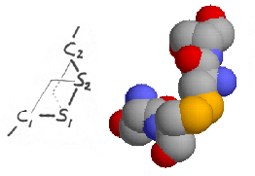
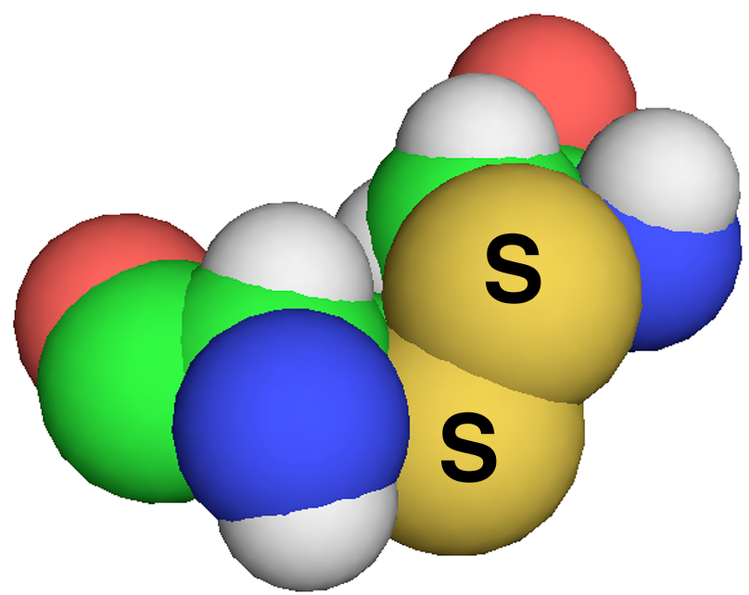
6 categories of interactions or, Why proteins have structure
N - H O = C
1. Hydrogen bonds
2. Electrostatic (Ion Pair, Salt Bridge)
3. Cysteine – Cysteine disulfide bond
N - H
10 - 40 kJ/Mole
o
O = C
2.8 - 3.2
A
o
Geometry: ~ straight line thru 3 atoms; Electronegative atoms are 2.8 - 3.2 A apart;
(Almost) Every OH, SH, NH is H-bonded to (1) Another part of protein; or (2) Water
The protein structure whatever it is must allow ~ every possible H-bond to form
+
O
=
-Asp
e.g. Lys- NH₃
C
10 - 40 kJ/Mole
O
-
Geometry: No directionality
A + and a - have equal, opposite charge within few Angstroms
On protein surface: this can be met by aqueous salt ions
Inside protein: when a charge is attracted and balanced by oppositely charged side chain, + − ,
called “ion pair” or “salt bridge”
is covalent
~ 200 kJ/Mole (compare C-C at ~ 350 kJ/Mole)
Weak for a covalent bond, but much stronger than e.g. H-bond
geometry: “zig-zag”
S
S
Notes:
In general, what are the “construction rules” for proteins? A large part of this story comes from the key interactions found in proteins:
1. Hydrogen Bonds: p. 52
• linear geometry; this holds the three atoms in a relatively precise relationship
• 2.8 - 3.2 Angstroms between the electronegative atoms
• energy of one hydrogen bond 10-40 kJ/mole
• every -OH, -NH, -SH must be in an H-bond, either to another part of the protein or to water. In whatever way the polypeptide chain actually folds, the FINAL STRUCTURE MUST ENABLE (ALMOST) EVERY POSSIBLE H-BOND TO FORM.
2. Electrostatics:
• positive and negative charge attracting, or else two like charges repelling
• wherever there is a + charge there must be a - charge within a few Angstroms, and vice versa
• energy of the attraction is 10-40 kJ/mole
• very different from H-bond in geometry: not constrained in any direction!
• attractive interaction often called a “salt bridge” or "ion pair"
3. Disulfide Bonds:
• have a specific geometry. This geometry best visualized in 3D as on bottom far right of p. 52.
• it is a covalent bond with an energy about 200 kJ/mole. This is only about half the strength of a typical carbon-carbon covalent bond, but much stronger than H-bonding or electrostatic interactions.

Slide 6
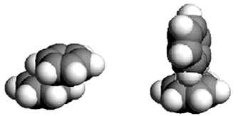
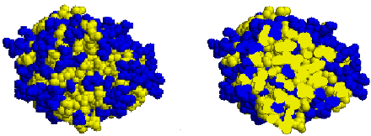
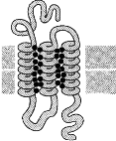
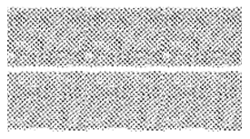
Electron shell repulsion + London dispersion = Van der Waals
4. Weak and weakly directional forces:
5. Ring-stacking (Phe, Tyr, & Trp)
6. Hydrophobic interaction
5-20 kJ/Mole
e⁻ clouds distort, giving transient dipoles
δ⁻
δ⁺
δ⁺
C
O
C
CH₃ CH₃ CH₃ ≡
δ⁺ δ⁻
δ⁺ δ⁻
δ⁺ δ⁻
=
=
=
O
C
+
O
δ⁻
δ⁺
Na
δ⁻
London dispersion force = transient dipoles
dipole-dipole
ion-dipole
The only attractive force for non-aromatic hydrocarbon!
10 - 40kJ/Mole
Two specific geometries occur in proteins
π electrons interact
Scales directly with surface area buried
Cys in disulfide very nonpolar,
Based on favorable water entropy!
Cys-S-S-Cys, Phe, Met, Ile,
Leu, Val, Cys, Trp, Ala
Surface
Interior
Note: membrane proteins follow different rules!
Nonpolar AA are in contact with membrane nonpolar interior
With protein
Nonpolar membrane interior
Nonpolar membrane interior
Polar/charged AA mainly not in contact with membrane interior
Notes:
4. Weak and Weakly Directional Interactions: p. 53
Three types, each worth approx 5-10 kJ/mol:
a. DIPOLE-DIPOLE: such as between two carbonyl groups. The partially negative oxygen is attracted to the partially positive carbon of another carbonyl group. It is weakly directional (see lecture demo).
b. ION-DIPOLE: such as between a carbonyl group and a NH3+ group. It is also weakly directional.
c. The third such interaction goes by three different names:
-- transient dipoles
-- van der Waals forces
-- London dispersion force
This interaction arises from the transient fluctuation of the charge distribution of the electron cloud. Fluctuation occurs rapidly, and since neighboring electron clouds deform "in concert", there is a net attraction. For purely aliphatic hydrocarbons, this is the ONLY attractive interaction! For other parts of the protein including polar atoms, these transient dipoles also occur, but are typically weaker than other interactions. The transient dipoles strongly favor close packing, with no space between the atoms.
5. Ring-stacking: worth about 10-40 kJ/mol
Aromatic rings have a favorable pi electron cloud interaction that results in two aromatic rings stacked face-to-face but slightly staggered, or one ring "on edge" touching the other, as shown on p. 53.
6. Hydrophobic interactions in total are the strongest of the interactions that drive 3D folding of the protein, with “individual” hydrophobic interactions being weak, but there are many of these interactions. All other interactions must be satisfied after the hydrophobic interaction has driven nonpolar AA residues out of water. It is difficult to give a quantitative measure of the magnitude, since there are a large number of hydrophobic interactions, each of which is weakly favorable. Even though weak, there are so many nonpolar groups that the total interaction is large.
Note that the hydrophobic interaction causes all water-soluble proteins to have the general structure: almost purely nonpolar inside, largely but not completely polar outside.
** But in contrast, the membrane proteins have nonpolar residues on the outside, in contact with the nonpolar interior of the lipid bilayer.
Membrane proteins have other different “rules”. For example, often Trp residues are found at the water/membrane interface. Trp has some polar and H-bonding character, along with some nonpolar character, and therefore it interacts well at the interface where membrane meets water.

Slide 7
Construction rules for protein folding into a 3D structure
6 types of interactions
Constraints created by the peptide bond together with the real size of atoms
Result: α-helix, β-sheet, turns, collagen helix
Notes:
We have now discussed one of the keys to understanding protein folding, or the protein "construction rules": the six types of interactions (pp 52-53).
These interactions, combined with the geometric constraints created by the peptide bond and the actual size of atoms (as defined by their electron cloud distribution), result in specific types of structures that we find in proteins: the alpha helix, beta sheet, different types of turns (including one that forms the collagen helix!).

